Slide 1





ASSESSING THE SHORT-TERM RENTAL MARKET OPPORTUNITY FOR WATERSHED
Analysis by PhD. Yang SHI
Aug 17th, 2022

Slide 2

Introduction
Watershed Properties:
A residential property management company
Manage serval thousand properties in more than 60 different neighborhoods around the US
Manage long-term leases (1 Year or more)
Short-term rentals (Ex : pay rent by the night rather than by the month)

Slide 3

Main Work
Calculate how much it would cost to convert and maintain each of this client’s properties as a short-term rental.
Determine the nightly rental price that would maximize the profits from each of these properties.
Calculate which properties would have increased profits as short-term rentals.
Determine the model of profitable.
Determine the financing account.

Slide 4
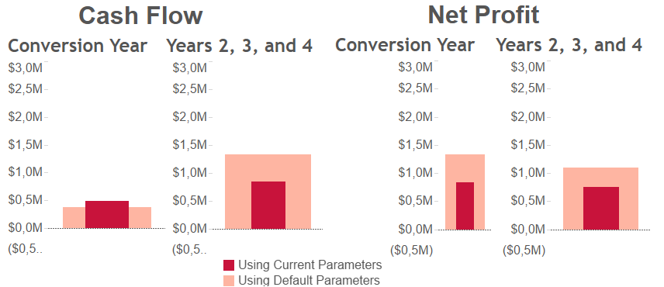

Cash Folw & Net Profit

Slide 5
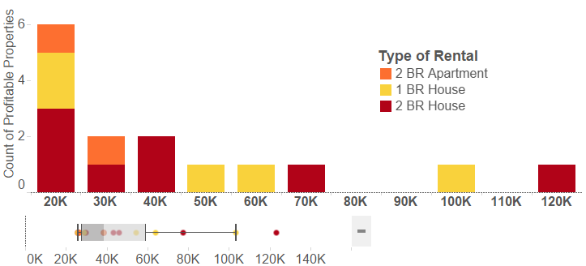

Distribution of the 15 Profitable Properties by Annual Net Profit after Conversion Year

Slide 6
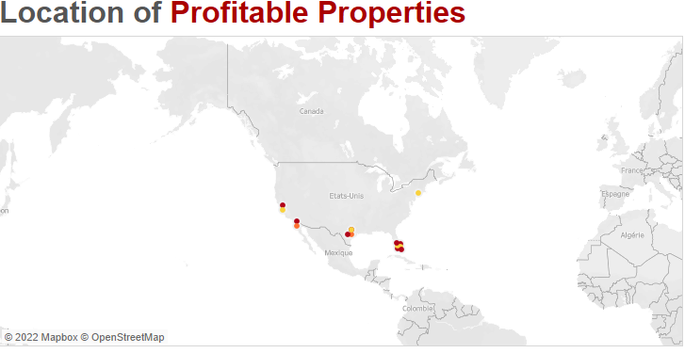
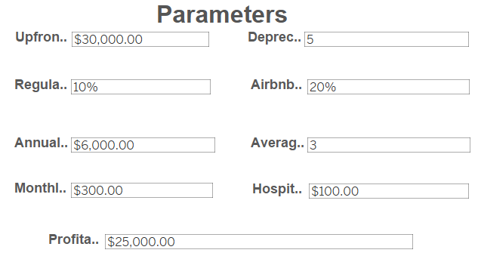
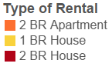

Location of Profitable Properties in US

Slide 7

Model Limitations
Factors not considered:
Marketing strategies, like discounts or coupons
Weekly or seasonal changes in tent or occupancy rate
Loss in rent during the time interval when proprties are being converted to short-term rental properties
Special enents during the year that might affect the rentals in one specific location
2. Revenue model is based on observed occupancy and price rates and therefore is not tested for possible shocks:
Significant changes in demande for hoursing
Significant changes in supply of hoursing

Slide 8

Thank you for your attention!

